Slide 1
Objectives
In this session, you will learn to:
Query data by using joins

Slide 2
Querying Data by Using Joins
What are Joins?

Slide 3
Querying Data by Using Joins (Contd.)
Joins:
Allow to retrieve data from multiple tables.
Can be of the following types:
Inner join
Outer join
Cross join
Equi join
Self join
Notes:
Student already have learnt about type 2 SCDs in Module I. Therefore, you can start this topic by asking the following questions to students:
What are type 2 SCDs?
Given an example to explain type 2 SCDs.
This will recapitulate what they have learnt about type 2 SCD in Module 1.
Now explain the strategy to update the data into these dimension tables with help the example given in SG.
After explaining the examples, you can ask students to think of an example of a type 2 SCD and then tell the strategy to update the data into this dimension table.

Slide 4
Using an Inner Join
Inner join:
Retrieves records from multiple tables after comparing values present in a common column.
Retrieves only those rows that satisfy the join condition.
Syntax:
SELECT column_name, column_name [,column_name]
FROM table1_name JOIN table2_name
ON table1_name.ref_column_name join_operator table2_name.ref_column_name
Notes:
4
Student already have learnt about type 2 SCDs in Module I. Therefore, you can start this topic by asking the following questions to students:
What are type 2 SCDs?
Given an example to explain type 2 SCDs.
This will recapitulate what they have learnt about type 2 SCD in Module 1.
Now explain the strategy to update the data into these dimension tables with help the example given in SG.
After explaining the examples, you can ask students to think of an example of a type 2 SCD and then tell the strategy to update the data into this dimension table.

Slide 5
Using an Inner Join (Contd.)
Let us now understand the working of inner join.

Slide 6
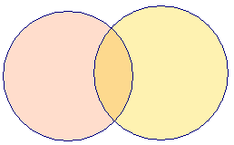
Using an Inner Join (Contd.)
COLUMNS
COLUMNS
A B C
B D E
Table X
Table Y
INNER JOIN
A B C D E
COMMON ROWS
OUTPUT
Notes:
Explain the diagram to the students. Tell them that, in the above diagram you can see that the common data from both the tables, Table X and Table Y is displayed. The data is displayed on the base of a common column, Column B.

Slide 7
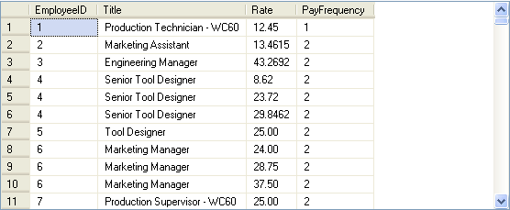
Using an Inner Join (Contd.)
For example:
SELECT e.EmployeeID,e.Title, eph.Rate,eph.PayFrequency
FROM HumanResources.Employee e JOIN HumanResources.EmployeePayHistory eph ON e.EmployeeID = eph.EmployeeID
Output
Employee table
EmployeePayHistory table
Notes:
You can summarize the session by running through the summary given in SG.
In addition, you can also ask students summarize what they have learnt in this session.

Slide 8
Using an Inner Join (Contd.)
An inner join is the default join. Therefore, you can also apply an inner join by using the JOIN keyword.

Slide 9
Just a minute
Why do you need a table alias with the column name?
Solution:
A table alias is required to uniquely identify columns in the SELECT query to avoid ambiguity that arises due to same column names in multiple tables.
Notes:
Student already have learnt about type 2 SCDs in Module I. Therefore, you can start this topic by asking the following questions to students:
What are type 2 SCDs?
Given an example to explain type 2 SCDs.
This will recapitulate what they have learnt about type 2 SCD in Module 1.
Now explain the strategy to update the data into these dimension tables with help the example given in SG.
After explaining the examples, you can ask students to think of an example of a type 2 SCD and then tell the strategy to update the data into this dimension table.

Slide 10
Using an Outer Join
Outer join:
Displays the result set containing all the rows from one table and the matching rows from another table.
Displays NULL for the columns of the related table where it does not find matching records.
Is of the following types:
Left outer join
Right outer join
Full outer join
Notes:
10
Student already have learnt about type 2 SCDs in Module I. Therefore, you can start this topic by asking the following questions to students:
What are type 2 SCDs?
Given an example to explain type 2 SCDs.
This will recapitulate what they have learnt about type 2 SCD in Module 1.
Now explain the strategy to update the data into these dimension tables with help the example given in SG.
After explaining the examples, you can ask students to think of an example of a type 2 SCD and then tell the strategy to update the data into this dimension table.

Slide 11
Using an Outer Join (Contd.)
Let us now understand how different types of outer joins work.

Slide 12

Using an Outer Join (Contd.)
COLUMNS
COLUMNS
A B C
B D E
Table X
Table Y
LEFT OUTER JOIN
A B C D E
ALL ROWS FROM TABLE X AND COMMON ROWS FROM TABLE Y
OUTPUT
Notes:
Explain the concept of the LEFT OUTER JOIN to the students using the diagram. Tell them, that as shown in the figure all the rows from first table, Table X are displayed. However, only the matching rows from the second table, Table Y, are displayed. Also tell them that the data is based on the common column between the tables, Column B.

Slide 13
Using an Outer Join (Contd.)
COLUMNS
COLUMNS
A B C
B D E
Table X
Table Y
RIGHT OUTER JOIN
A B C D E
ALL ROWS FROM TABLE Y AND COMMON ROWS FROM TABLE X
OUTPUT
Notes:
Explain the concept of the RIGHT OUTER JOIN to the students using the diagram. Tell them, that as shown in the figure all the rows from second table, Table Y are displayed. However, only the matching rows from the first table, Table X, are displayed. Also tell them that the data is based on the common column between the tables, Column B.

Slide 14
Using an Outer Join (Contd.)
COLUMNS
COLUMNS
A B C
B D E
Table X
Table Y
FULL OUTER JOIN
A B C D E
ALL ROWS FROM TABLE Y AND TABLE Y AND COMMON ROWS ONLY ONCE
OUTPUT
Notes:
Explain the concept of the FULL OUTER join to the students. Tell them that full outer join is a combination of LEFT OUTER join and RIGHT OUTER join. This join returns all the matching and non-matching rows from both the tables.

Slide 15
Using an Outer Join (Contd.)
Syntax:
SELECT column_name, column_name [,column_name]
FROM table1_name [LEFT | RIGHT| FULL] OUTER JOIN table2_name ON table1_name.ref_column_name join_operator table2_name.ref_column_name
Notes:
15
Student already have learnt about type 2 SCDs in Module I. Therefore, you can start this topic by asking the following questions to students:
What are type 2 SCDs?
Given an example to explain type 2 SCDs.
This will recapitulate what they have learnt about type 2 SCD in Module 1.
Now explain the strategy to update the data into these dimension tables with help the example given in SG.
After explaining the examples, you can ask students to think of an example of a type 2 SCD and then tell the strategy to update the data into this dimension table.

Slide 16
Using an Outer Join (Contd.)
Left outer join:
Returns all rows from the table specified on the left side of the LEFT OUTER JOIN keyword and the matching rows from the table specified on the right side.
Displays NULL for the columns of the table specified on the right side where it does not find matching records.
For example:
SELECT DISTINCT (p.ProductID), p1.SpecialOfferID,
p1.SalesOrderID, p1.OrderQty, p1.UnitPrice
FROM Sales.SpecialOfferProduct p LEFT OUTER JOIN
[Sales].[SalesOrderDetail] p1 ON p.ProductID
=p1.ProductID
ORDER BY p.ProductID
Notes:
16
Student already have learnt about type 2 SCDs in Module I. Therefore, you can start this topic by asking the following questions to students:
What are type 2 SCDs?
Given an example to explain type 2 SCDs.
This will recapitulate what they have learnt about type 2 SCD in Module 1.
Now explain the strategy to update the data into these dimension tables with help the example given in SG.
After explaining the examples, you can ask students to think of an example of a type 2 SCD and then tell the strategy to update the data into this dimension table.

Slide 17
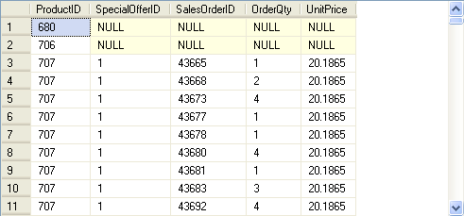
Using an Outer Join (Contd.)
The following figure displays the output of the preceding query.
Displays NULL for the ProductIDs for which no transaction was performed.
Notes:
17
Student already have learnt about type 2 SCDs in Module I. Therefore, you can start this topic by asking the following questions to students:
What are type 2 SCDs?
Given an example to explain type 2 SCDs.
This will recapitulate what they have learnt about type 2 SCD in Module 1.
Now explain the strategy to update the data into these dimension tables with help the example given in SG.
After explaining the examples, you can ask students to think of an example of a type 2 SCD and then tell the strategy to update the data into this dimension table.

Slide 18
Using an Outer Join (Contd.)
Right outer join:
Returns all the rows from the table specified on the right side of the RIGHT OUTER JOIN keyword.
Returns the matching rows from the table specified on the left side.
For example:
SELECT st.Name AS Territory, sp.SalesPersonID
FROM Sales.SalesTerritory st
RIGHT OUTER JOIN Sales.SalesPerson sp
ON st.TerritoryID = sp.TerritoryID
Notes:
18
Student already have learnt about type 2 SCDs in Module I. Therefore, you can start this topic by asking the following questions to students:
What are type 2 SCDs?
Given an example to explain type 2 SCDs.
This will recapitulate what they have learnt about type 2 SCD in Module 1.
Now explain the strategy to update the data into these dimension tables with help the example given in SG.
After explaining the examples, you can ask students to think of an example of a type 2 SCD and then tell the strategy to update the data into this dimension table.

Slide 19
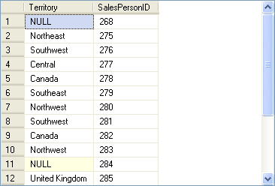
Using an Outer Join (Contd.)
The following figure displays the output of the preceding query.
Displays NULL in the Territory column for those sales persons who have not been assigned any territory.
Notes:
19
Student already have learnt about type 2 SCDs in Module I. Therefore, you can start this topic by asking the following questions to students:
What are type 2 SCDs?
Given an example to explain type 2 SCDs.
This will recapitulate what they have learnt about type 2 SCD in Module 1.
Now explain the strategy to update the data into these dimension tables with help the example given in SG.
After explaining the examples, you can ask students to think of an example of a type 2 SCD and then tell the strategy to update the data into this dimension table.

Slide 20
Using an Outer Join (Contd.)
Full outer join:
Is a combination of left outer join and right outer join.
Returns all the matching and non-matching rows from both the tables.
For example:
SELECT st.Name AS Territory, sp.SalesPersonID
FROM Sales.SalesTerritory st
FULL OUTER JOIN Sales.SalesPerson sp
ON st.TerritoryID = sp.TerritoryID
Notes:
20
Student already have learnt about type 2 SCDs in Module I. Therefore, you can start this topic by asking the following questions to students:
What are type 2 SCDs?
Given an example to explain type 2 SCDs.
This will recapitulate what they have learnt about type 2 SCD in Module 1.
Now explain the strategy to update the data into these dimension tables with help the example given in SG.
After explaining the examples, you can ask students to think of an example of a type 2 SCD and then tell the strategy to update the data into this dimension table.

Slide 21
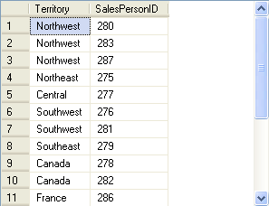
Using an Outer Join (Contd.)
The following figure displays the output of the preceding query.
Displays NULL values in the SalesPersonID column for those territories which have not been assigned to any sales person.
Displays NULL values in the Territory column for those sales persons who have not been assigned any territory.
Notes:
21
Student already have learnt about type 2 SCDs in Module I. Therefore, you can start this topic by asking the following questions to students:
What are type 2 SCDs?
Given an example to explain type 2 SCDs.
This will recapitulate what they have learnt about type 2 SCD in Module 1.
Now explain the strategy to update the data into these dimension tables with help the example given in SG.
After explaining the examples, you can ask students to think of an example of a type 2 SCD and then tell the strategy to update the data into this dimension table.

Slide 22
Just a minute
When do you use the right outer join?
Solution:
You can use the right outer join when you need all the records from the table at the right side of the outer join and only matching records from the table at the left side of the outer join.
Notes:
Student already have learnt about type 2 SCDs in Module I. Therefore, you can start this topic by asking the following questions to students:
What are type 2 SCDs?
Given an example to explain type 2 SCDs.
This will recapitulate what they have learnt about type 2 SCD in Module 1.
Now explain the strategy to update the data into these dimension tables with help the example given in SG.
After explaining the examples, you can ask students to think of an example of a type 2 SCD and then tell the strategy to update the data into this dimension table.

Slide 23
Using a Cross Join
Cross join:
Is also known as the Cartesian Product.
Joins each row from one table with each row of the other table.
Let us now understand the working of cross join.
Notes:
23
Student already have learnt about type 2 SCDs in Module I. Therefore, you can start this topic by asking the following questions to students:
What are type 2 SCDs?
Given an example to explain type 2 SCDs.
This will recapitulate what they have learnt about type 2 SCD in Module 1.
Now explain the strategy to update the data into these dimension tables with help the example given in SG.
After explaining the examples, you can ask students to think of an example of a type 2 SCD and then tell the strategy to update the data into this dimension table.

Slide 24
Using a Cross Join (Contd.)
COLUMNS
COLUMNS
A B C
B D E
Table X
Table Y
CROSS JOIN
m ROWS
n ROWS
A B C D E
ALL ROWS (n X m)
EACH ROW OF TABLE X JOINED WITH EACH ROW OF TABLE Y
OUTPUT
Notes:
Explain the concept of CROSS JOIN to the students. Tell them that CROSS JOIN displays a combination of all the rows from one table with all the rows from the other one. Also tell them that it shows the Cartesian Product between the rows of first and second table.
FAQs
Question: What is the difference between FULL OUTER JOIN and CROSS JOIN?
Answer: A FULL OUTER JOIN displays all matching and non-matching rows from both the tables and displays NULL in place of non-matching rows. Whereas, a CROSS JOIN displays all the possible combination of all the rows in both the tables.
Additional Input
A Cartesian Product is the set of all possible ordered pairs between two sets.

Slide 25
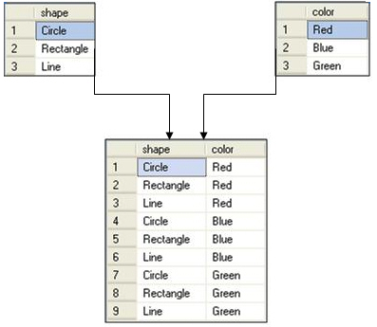
Using a Cross Join (Contd.)
For example, consider the following figure.
The result set contains nine rows.
Notes:
Student already have learnt about type 2 SCDs in Module I. Therefore, you can start this topic by asking the following questions to students:
What are type 2 SCDs?
Given an example to explain type 2 SCDs.
This will recapitulate what they have learnt about type 2 SCD in Module 1.
Now explain the strategy to update the data into these dimension tables with help the example given in SG.
After explaining the examples, you can ask students to think of an example of a type 2 SCD and then tell the strategy to update the data into this dimension table.

Slide 26
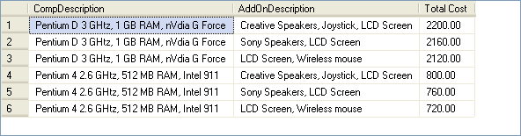
Using a Cross Join (Contd.)
Consider the following query:
SELECT A.CompDescription, B.AddOnDescription, A.Price + B.Price AS 'Total Cost' FROM ComputerDetails A CROSS JOIN AddOnDetails B
Output
Combines the records of both the tables to display the total price of a computer with all the possible combinations.
Notes:
Student already have learnt about type 2 SCDs in Module I. Therefore, you can start this topic by asking the following questions to students:
What are type 2 SCDs?
Given an example to explain type 2 SCDs.
This will recapitulate what they have learnt about type 2 SCD in Module 1.
Now explain the strategy to update the data into these dimension tables with help the example given in SG.
After explaining the examples, you can ask students to think of an example of a type 2 SCD and then tell the strategy to update the data into this dimension table.

Slide 27
Using an Equi Join
Equi join:
Is the same as an inner join and joins tables with the help of a foreign key.
Is used to display all the columns from both the tables.
Let us now understand the working of an equi join.
Notes:
27
Student already have learnt about type 2 SCDs in Module I. Therefore, you can start this topic by asking the following questions to students:
What are type 2 SCDs?
Given an example to explain type 2 SCDs.
This will recapitulate what they have learnt about type 2 SCD in Module 1.
Now explain the strategy to update the data into these dimension tables with help the example given in SG.
After explaining the examples, you can ask students to think of an example of a type 2 SCD and then tell the strategy to update the data into this dimension table.

Slide 28
Using an Equi Join (Contd.)
COLUMNS
COLUMNS
A B C
B D E
Table X
Table Y
EQUI JOIN
A B C D B E
COMMON ROWS
OUTPUT
Notes:
Explain the concept of EQUI join to the student.

Slide 29
Using an Equi Join (Contd.)
For example:
SELECT * FROM HumanResources.EmployeeDepartmentHistory d JOIN HumanResources.Employee e ON d.EmployeeID = e.EmployeeID JOIN HumanResources.Department p ON p.DepartmentID = d.DepartmentID
Notes:
29
Student already have learnt about type 2 SCDs in Module I. Therefore, you can start this topic by asking the following questions to students:
What are type 2 SCDs?
Given an example to explain type 2 SCDs.
This will recapitulate what they have learnt about type 2 SCD in Module 1.
Now explain the strategy to update the data into these dimension tables with help the example given in SG.
After explaining the examples, you can ask students to think of an example of a type 2 SCD and then tell the strategy to update the data into this dimension table.

Slide 30
Using an Equi Join (Contd.)
For example:
SELECT * FROM HumanResources.EmployeeDepartmentHistory d JOIN HumanResources.Employee e ON d.EmployeeID = e.EmployeeID JOIN HumanResources.Department p ON p.DepartmentID = d.DepartmentID
Applies an equi join between the EmployeeDepartmentHistory, Employee, and Department tables by using a common column, EmployeeID.
Notes:
30
Student already have learnt about type 2 SCDs in Module I. Therefore, you can start this topic by asking the following questions to students:
What are type 2 SCDs?
Given an example to explain type 2 SCDs.
This will recapitulate what they have learnt about type 2 SCD in Module 1.
Now explain the strategy to update the data into these dimension tables with help the example given in SG.
After explaining the examples, you can ask students to think of an example of a type 2 SCD and then tell the strategy to update the data into this dimension table.

Slide 31
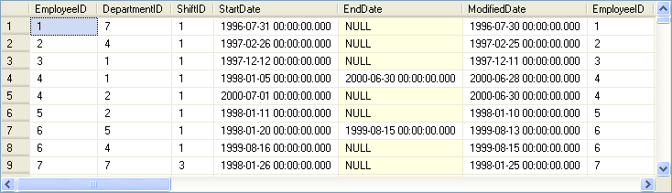
Using an Equi Join (Contd.)
The following figure displays the output of the preceding query.
Displays the EmployeeID column from all the tables.
Notes:
31
Student already have learnt about type 2 SCDs in Module I. Therefore, you can start this topic by asking the following questions to students:
What are type 2 SCDs?
Given an example to explain type 2 SCDs.
This will recapitulate what they have learnt about type 2 SCD in Module 1.
Now explain the strategy to update the data into these dimension tables with help the example given in SG.
After explaining the examples, you can ask students to think of an example of a type 2 SCD and then tell the strategy to update the data into this dimension table.

Slide 32
Just a minute
What is the difference between an equi join and an inner join?
Solution:
In an equi join, you can use only the equality operator to specify the join condition, whereas in an inner join you have the flexibility to use other conditional operators.
Notes:
Student already have learnt about type 2 SCDs in Module I. Therefore, you can start this topic by asking the following questions to students:
What are type 2 SCDs?
Given an example to explain type 2 SCDs.
This will recapitulate what they have learnt about type 2 SCD in Module 1.
Now explain the strategy to update the data into these dimension tables with help the example given in SG.
After explaining the examples, you can ask students to think of an example of a type 2 SCD and then tell the strategy to update the data into this dimension table.

Slide 33
Using a Self Join
Self join:
A table is joined with itself.
One row in a table correlates with other rows in the same table.
A table name is used twice by giving two alias names in the query.
Notes:
33
Student already have learnt about type 2 SCDs in Module I. Therefore, you can start this topic by asking the following questions to students:
What are type 2 SCDs?
Given an example to explain type 2 SCDs.
This will recapitulate what they have learnt about type 2 SCD in Module 1.
Now explain the strategy to update the data into these dimension tables with help the example given in SG.
After explaining the examples, you can ask students to think of an example of a type 2 SCD and then tell the strategy to update the data into this dimension table.

Slide 34
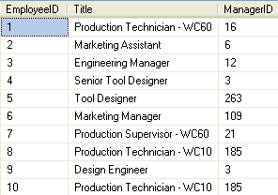
Using a Self Join (Contd.)
Consider the Employee table, as shown in the following figure.
Notes:
34
Student already have learnt about type 2 SCDs in Module I. Therefore, you can start this topic by asking the following questions to students:
What are type 2 SCDs?
Given an example to explain type 2 SCDs.
This will recapitulate what they have learnt about type 2 SCD in Module 1.
Now explain the strategy to update the data into these dimension tables with help the example given in SG.
After explaining the examples, you can ask students to think of an example of a type 2 SCD and then tell the strategy to update the data into this dimension table.

Slide 35
Using a Self Join (Contd.)
To display the employee details along with their manager details, you can use a self join.

Slide 36
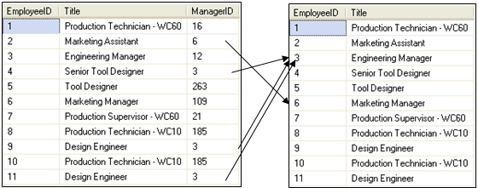
Using a Self Join (Contd.)
To perform self-join, you need to divide the physical tables into two logical tables, as shown in the following figure.
Employee (emp)
Employee (mgr)
Emp.ManagerID = mgr.EmployeeID
Notes:
36
Student already have learnt about type 2 SCDs in Module I. Therefore, you can start this topic by asking the following questions to students:
What are type 2 SCDs?
Given an example to explain type 2 SCDs.
This will recapitulate what they have learnt about type 2 SCD in Module 1.
Now explain the strategy to update the data into these dimension tables with help the example given in SG.
After explaining the examples, you can ask students to think of an example of a type 2 SCD and then tell the strategy to update the data into this dimension table.

Slide 37
Using a Self Join (Contd.)
The following query joins the Employee table with itself:
SELECT emp.EmployeeID, emp.Title AS Employee_Designation, emp.ManagerID, mgr.Title AS Manager_Designation FROM HumanResources.Employee emp, HumanResources.Employee mgr WHERE emp.ManagerID = mgr.EmployeeID
Notes:
37
Student already have learnt about type 2 SCDs in Module I. Therefore, you can start this topic by asking the following questions to students:
What are type 2 SCDs?
Given an example to explain type 2 SCDs.
This will recapitulate what they have learnt about type 2 SCD in Module 1.
Now explain the strategy to update the data into these dimension tables with help the example given in SG.
After explaining the examples, you can ask students to think of an example of a type 2 SCD and then tell the strategy to update the data into this dimension table.

Slide 38
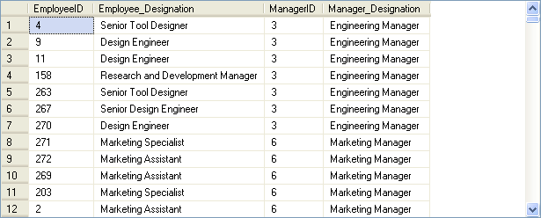
Using a Self Join (Contd.)
The output of the preceding query is shown in the following figure.
Notes:
38
Student already have learnt about type 2 SCDs in Module I. Therefore, you can start this topic by asking the following questions to students:
What are type 2 SCDs?
Given an example to explain type 2 SCDs.
This will recapitulate what they have learnt about type 2 SCD in Module 1.
Now explain the strategy to update the data into these dimension tables with help the example given in SG.
After explaining the examples, you can ask students to think of an example of a type 2 SCD and then tell the strategy to update the data into this dimension table.

Slide 39
Demo: Using Joins
Problem Statement:
The HR manager of AdventureWorks, Inc. requires a report containing the following details:
Employee ID
Employee name
Department name
Date of joining
Employee address
How will you generate this report?
Notes:
You can summarize the session by running through the summary given in SG.
In addition, you can also ask students summarize what they have learnt in this session.

Slide 40
Demo: Using Joins (Contd.)
Solution:
To generate the required report, you need to perform the following tasks:
1. Identify the join.
2. Create a query based on the identified join.
3. Execute the query to verify the result.
Notes:
You can summarize the session by running through the summary given in SG.
In addition, you can also ask students summarize what they have learnt in this session.

Slide 41
Summary
In this session, you learned that:
Joins and subqueries are used to retrieve data from multiple tables.
An inner join combines records from multiple tables by using a comparison operator on a common column.
A left outer join returns all the rows from the left table and the matching rows from the right table.
A right outer join returns all the rows from the right table and the matching rows from the left table.
A full outer join returns all the matching and non-matching rows from both the tables on which the join is applied.
A cross join returns each row from the first table joined with each row from the second table.
Notes:
You can summarize the session by running through the summary given in SG.
In addition, you can also ask students summarize what they have learnt in this session.

Slide 42
Summary (Contd.)
In an equi join, only the equality operator is used to specify the join condition.
A self join correlates one row in a table with other rows in the same table.
Notes:
You can summarize the session by running through the summary given in SG.
In addition, you can also ask students summarize what they have learnt in this session.

